Slide 1




Machine Learning Approaches to Social Media Mining
Đào Tuấn Vũ
CTO DYNO

Slide 2



DYNO
DYNO.vn: Big data services for Fintech and Online Advertising
AdFlex.asia: Top 1 CPA network in Viet Nam
MasOffer.net: Top 1 CPS network in Viet Nam
iHR: Big data for recruiting
eDoctor.io: Platform for healthcare

Slide 3

What is data mining?
“Data mining is the process of discovering patterns in large data sets involving methods at the intersection of machine learning, statistics, and database systems” – Wikipedia

Slide 4


What is social media?
Social media is defined as a group of Internet-based applications that allow the creation and exchanges of user- generated content.
Social media gives users an easy-to-use way to communicate and network with each other on an unprecedented scale.
Facebook, the social networking site, recorded more than 2.20 billion monthly active Facebook users for Q1 2018 (Facebook MAUs) which is a 13 percent increase year over year

Slide 5
Classification of social media
Online social networking: facebook
Blogging: medium
Micro-blogging: twitter
Wikis: wikipedia
Media sharing: youtube
Answers: quora

Slide 6
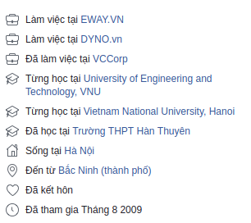
Data on social media
Structured data
Unstructured data: Every 60 seconds on Facebook:
510.000 comments are posted, (734M per day)
293.000 statuses are updated,
and 136.000 photos are uploaded

Slide 7
Challenges
Social media data are
vast
noisy
distributed
unstructured
dynamic.
These characteristics pose challenges to data mining tasks to invent new efficient techniques and algorithms.

Slide 8
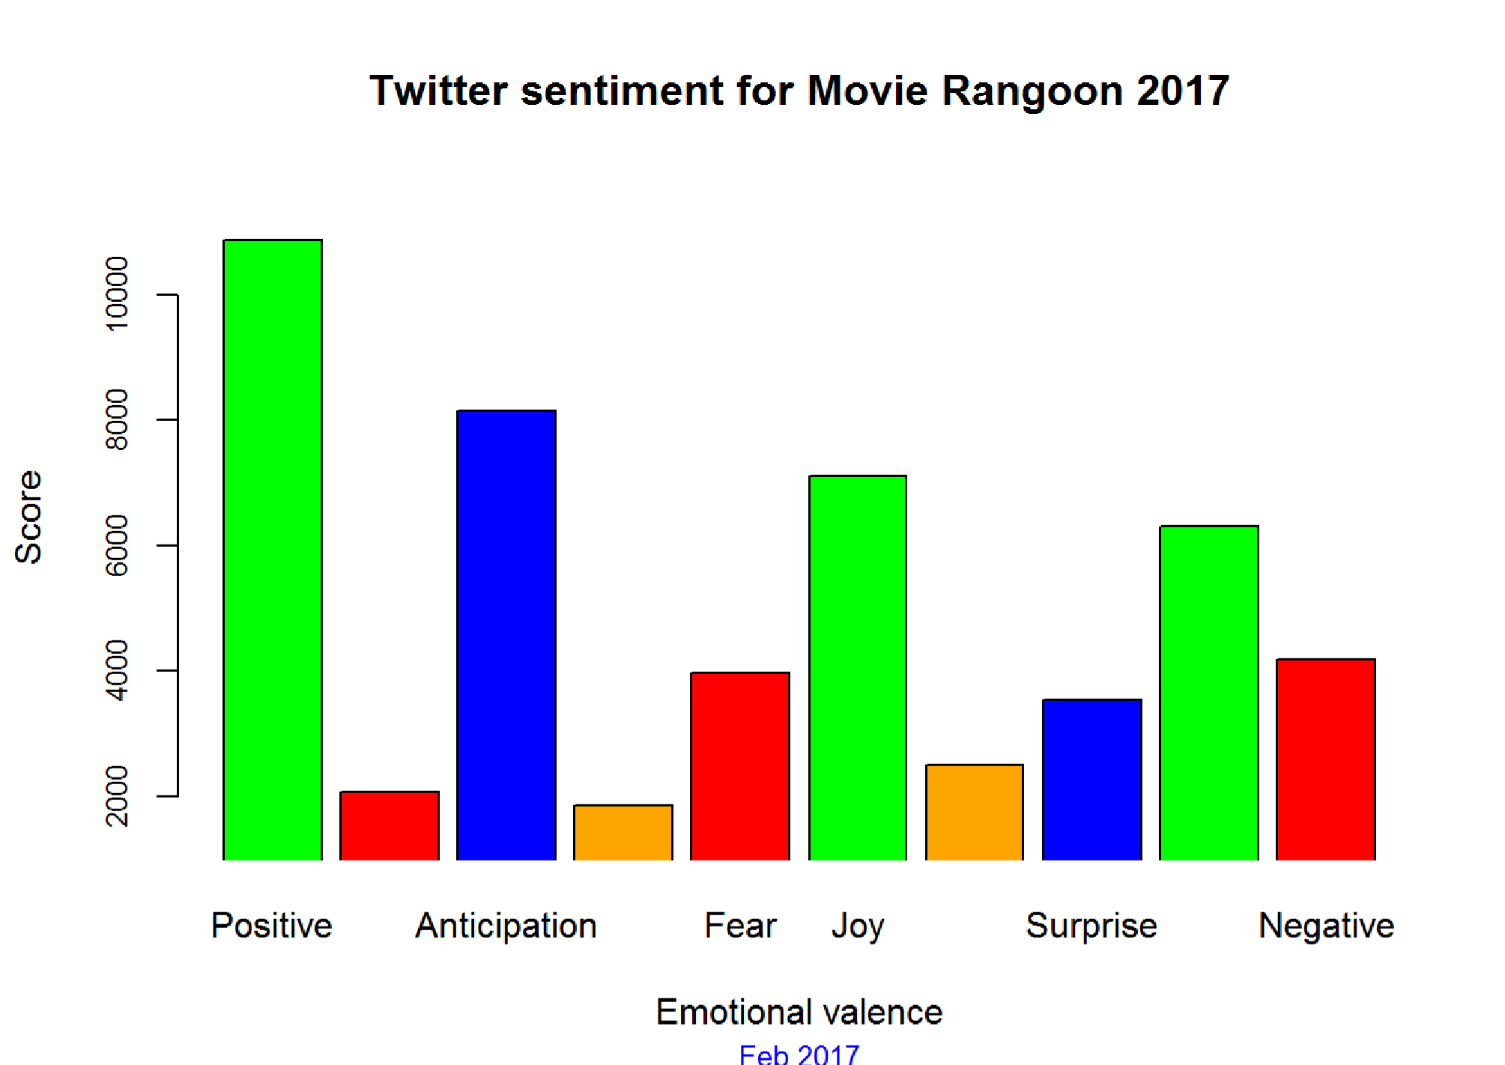
Sentiment Analysis and Opinion Mining
https://www.analyticsvidhya.com/blog/2017/03/measuring-audience-sentiments-about-movies-using-twitter-and-text-analytics/

Slide 9

Influence Modeling

Slide 10
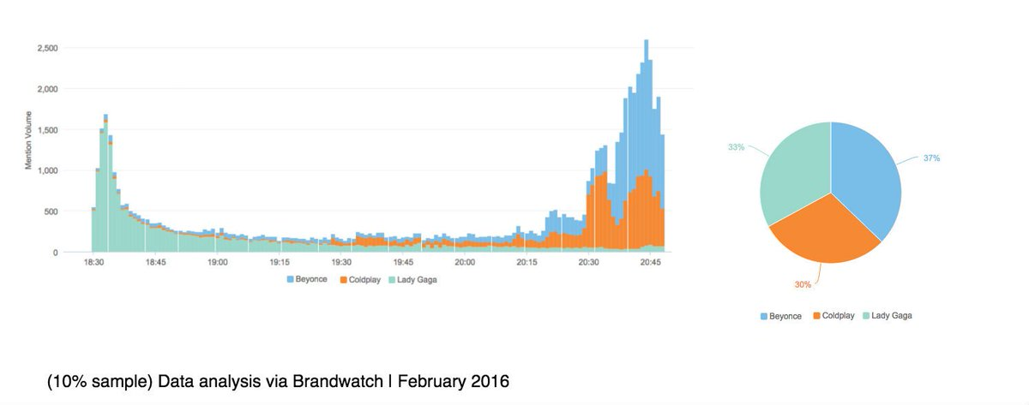
Social media event detection

Slide 11
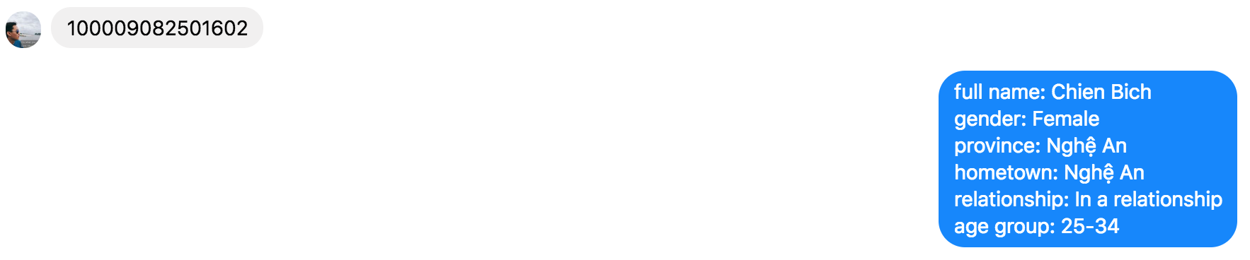
Mining user demographic

Slide 12
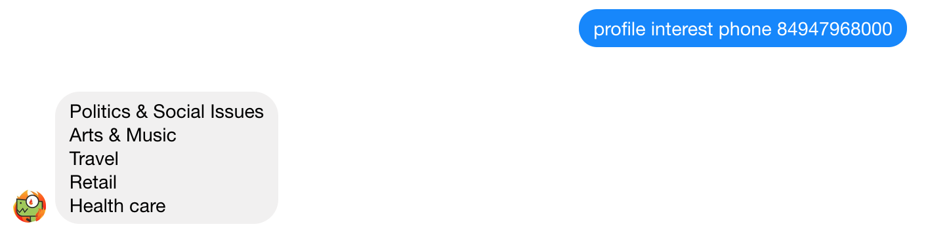
Mining user interest

Slide 13
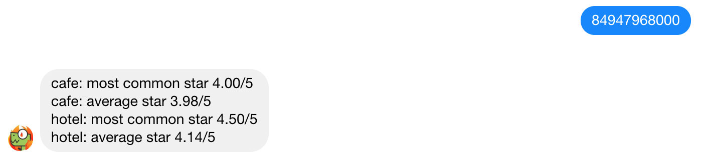
Mining customers usage of service

Slide 14
DYNO Machine Learning
1. Understanding of business problem 2. Problem formalization
3. Data collecting
4. Data preprocessing
5. Modelling
6. Way to evaluate model in real life
7. Way to deploy model

Slide 15
1. Understanding of business problem
What do you want to do?
For what?
Marketing
What are interests of a profile?
Fintech
What is the credit scoring of a profile?
HR
What is his job and does he want to quit his job?
User Profile
What is gender of a profile?

Slide 16
2. Problem formalization
Know exactly you want to do.
What is definition of interest?
What is definition of credit scoring?
What is definition of gender?

Slide 17

3. Data collecting
Is data is on the warehouse or need to be crawled from outside?
The coverage of data?
Gender:
Name
Tweet
Follower
Following

Slide 18
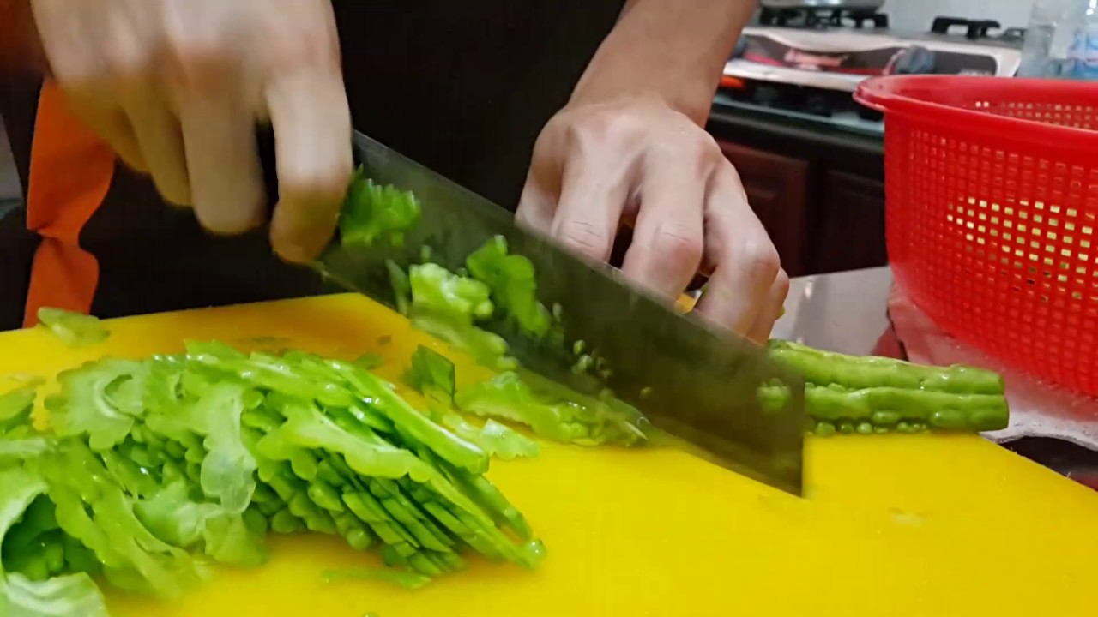
4. Data preprocessing
Clean the data
Feature preprocessing
Feature engineering

Slide 19
5. Modeling
Choice of target metric
Accuracy
Recall
Inference speed
Is model too slow?

Slide 20
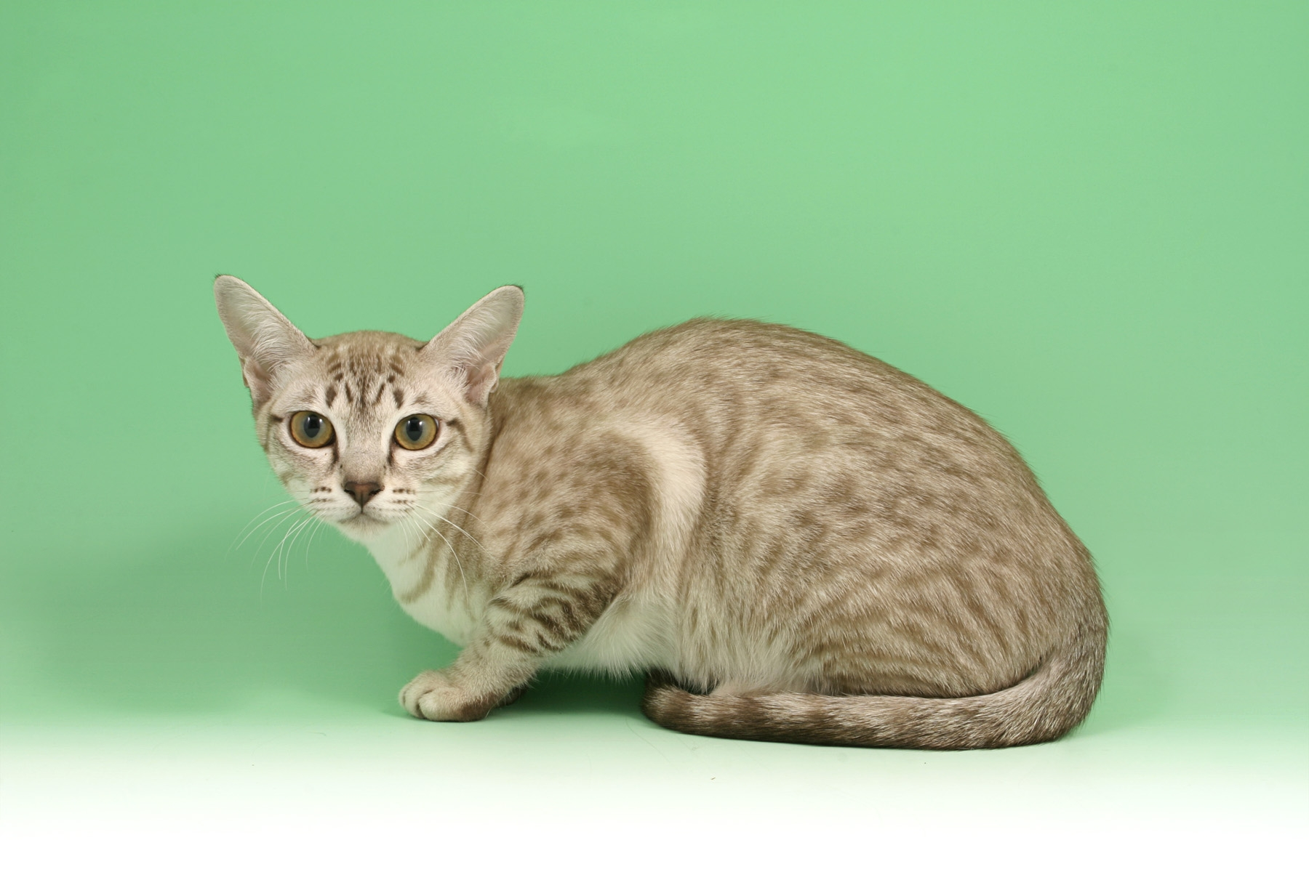

6. Way to evaluate model in real life
Short Hair Cat
Long Hair Cat

Slide 21



7. Way to deploy model
Ml engine
compute engine
Your own

Slide 22

DYNO Machine Learning

Slide 23
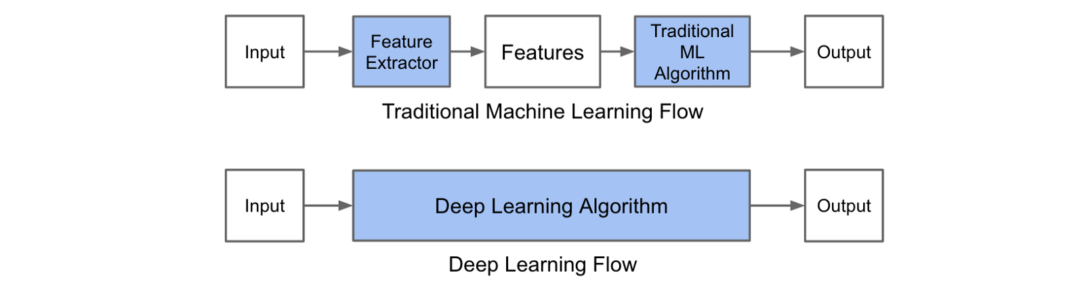
DYNO Machine Learning

Slide 24
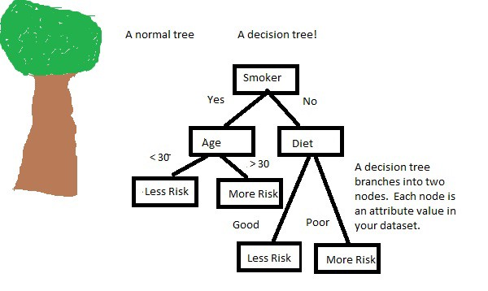
Tree based model

Slide 25
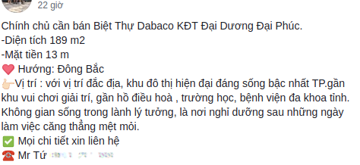
Text analysis

Slide 26

Image analysis

Slide 27
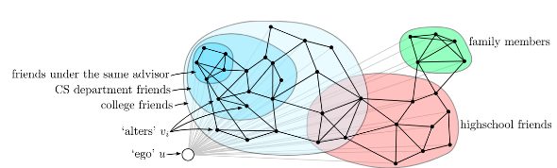
Graph analysis

Slide 28
Welcome on board
Data engineer - https://eway.vn/data-engineer
Data scientist - https://eway.vn/data-scientist
hr@eway.vn
vudt@eway.vn

Slide 29
Thank you!

